Slide 1


AGE Classification
Age, Gender and Ethnicity
By Bavly Benyamin, Supervised by Prof. Nahla Barakat

Slide 2
AGE Classification
Age, Gender and Ethnicity
By Bavly Benyamin, Supervised by Prof. Nahla Barakat
Outline
Problem and project motivation
Solution methodology and design
Implementation
Trials and results
Analysis and discussion – project essence
Conclusion and contributions
Web application demo
Q&A

Slide 3
AGE Classification
Age, Gender and Ethnicity
By Bavly Benyamin, Supervised by Prof. Nahla Barakat
Problem and motivation
Human profiling
AGE Classification
Realistic bins
Enforce legal requirements
Targeted advertising
Content filtering

Slide 4
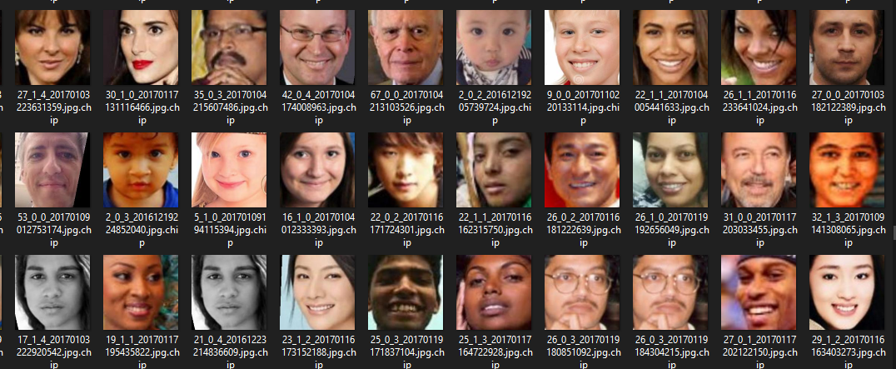

AGE Classification
Age, Gender and Ethnicity
By Bavly Benyamin, Supervised by Prof. Nahla Barakat
Solution methodology and design
Dataset: UTKFace [1]
[age]_[gender]_[race]_[date&time].jpg
[age] is an integer from 0 to 116, indicating the age
[gender] is either 0 (male) or 1 (female)
[race] is an integer from 0 to 4, denoting White, Black, Asian, Indian, and Others
For example, 28_0_3_20170117202327093.jpg refers to an Indian 28 year old male.

Slide 5
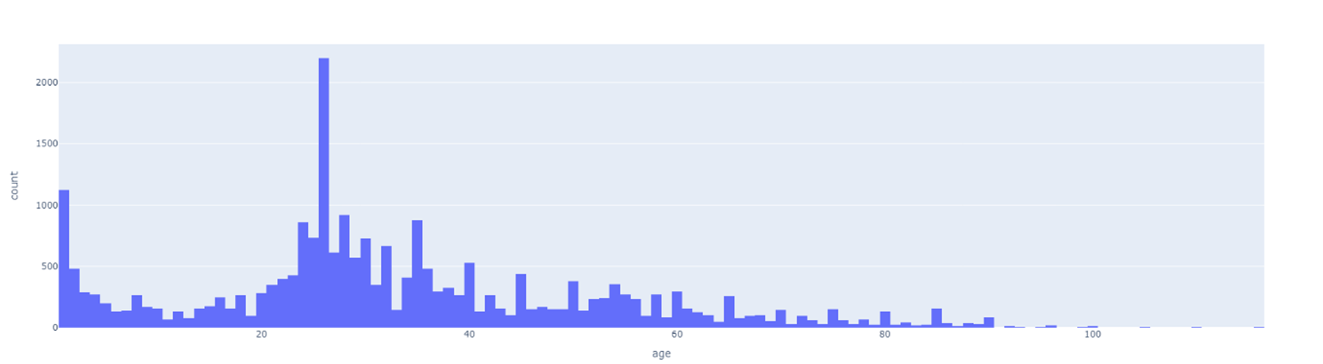
AGE Classification
Age, Gender and Ethnicity
By Bavly Benyamin, Supervised by Prof. Nahla Barakat
Solution methodology and design
Dataset: UTKFace [1]

Slide 6
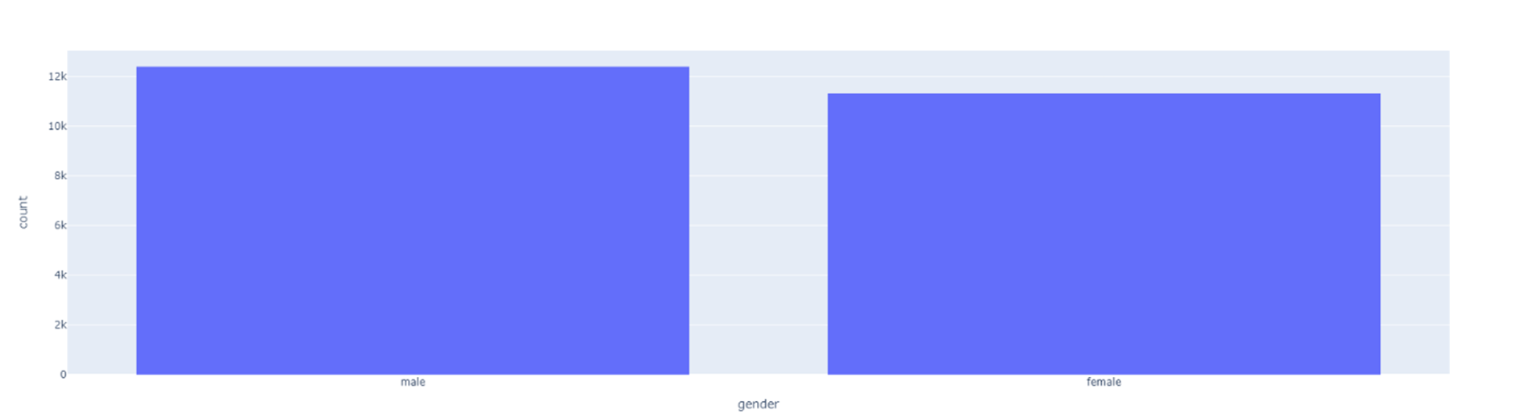
AGE Classification
Age, Gender and Ethnicity
By Bavly Benyamin, Supervised by Prof. Nahla Barakat
Solution methodology and design
Dataset: UTKFace [1]

Slide 7
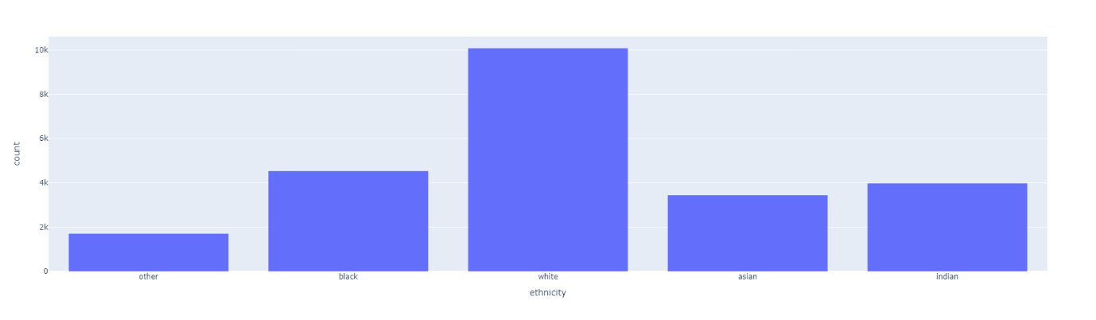
AGE Classification
Age, Gender and Ethnicity
By Bavly Benyamin, Supervised by Prof. Nahla Barakat
Solution methodology and design
Dataset: UTKFace [1]

Slide 8
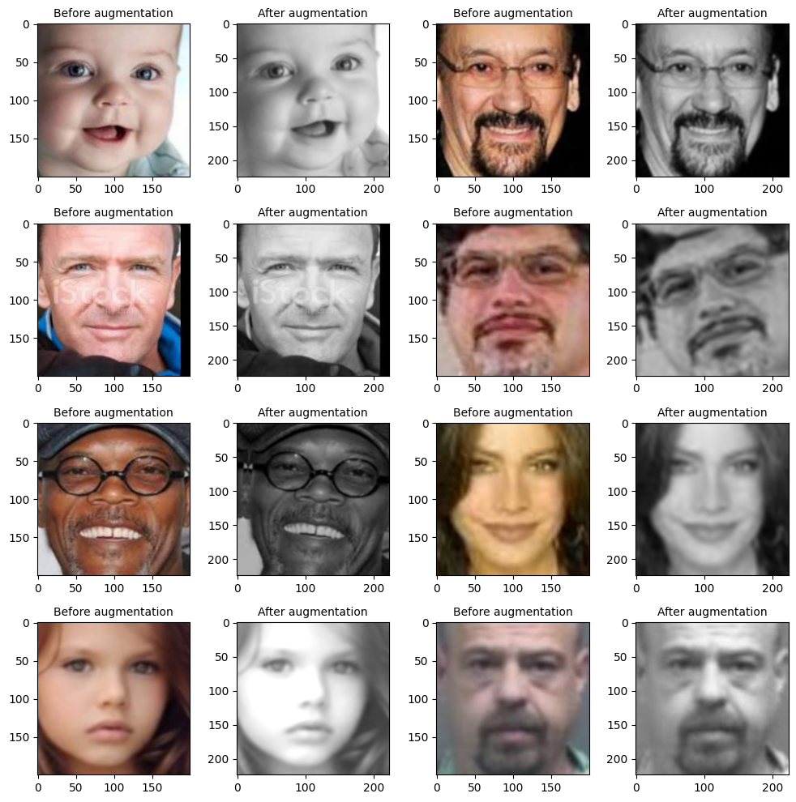
AGE Classification
Age, Gender and Ethnicity
By Bavly Benyamin, Supervised by Prof. Nahla Barakat
Solution methodology and design
Preprocessing: main takeaways
Age bins/categories
Image size
Data augmentations
Normalization
Color format

Slide 9
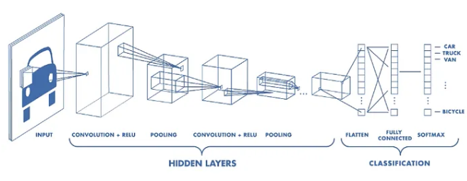
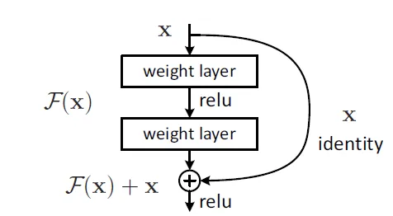
AGE Classification
Age, Gender and Ethnicity
By Bavly Benyamin, Supervised by Prof. Nahla Barakat
Solution methodology and design
Deep learning architectures
Traditional CNN
VGG
ResNet
DenseNet
InceptionResnet

Slide 10
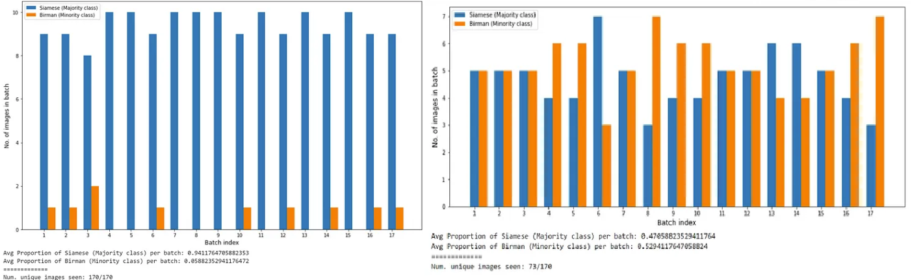
AGE Classification
Age, Gender and Ethnicity
By Bavly Benyamin, Supervised by Prof. Nahla Barakat
Solution methodology and design
Advanced learning techniques
Weighted random sampler
Residual Attention

Slide 11
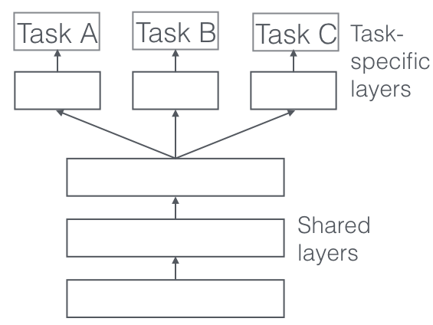
AGE Classification
Age, Gender and Ethnicity
By Bavly Benyamin, Supervised by Prof. Nahla Barakat
Solution methodology and design
Advanced learning techniques
Transfer learning
Hierarchical models
Multitasking

Slide 12
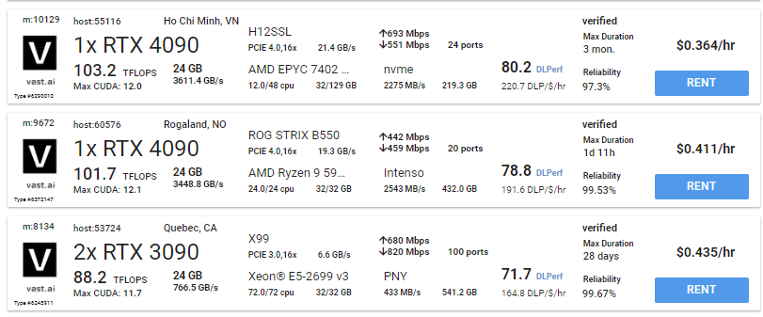
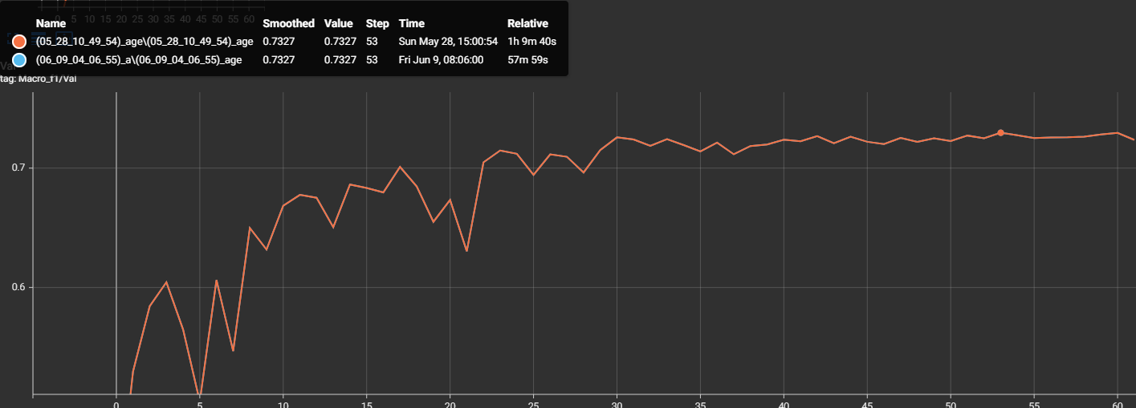
AGE Classification
Age, Gender and Ethnicity
By Bavly Benyamin, Supervised by Prof. Nahla Barakat
Implementation
Environment
Vast.ai (dockerization)
backblaze
PyTorch Lightning
Determinism and reproducibility

Slide 13
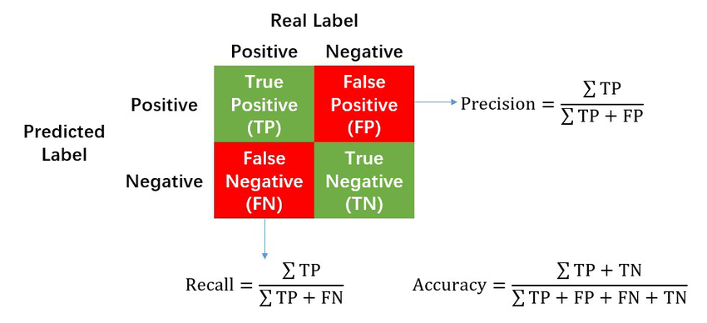
AGE Classification
Age, Gender and Ethnicity
By Bavly Benyamin, Supervised by Prof. Nahla Barakat
Trials and results
Performance metrics
Accuracy, Precision and Recall
F1 score

Slide 14
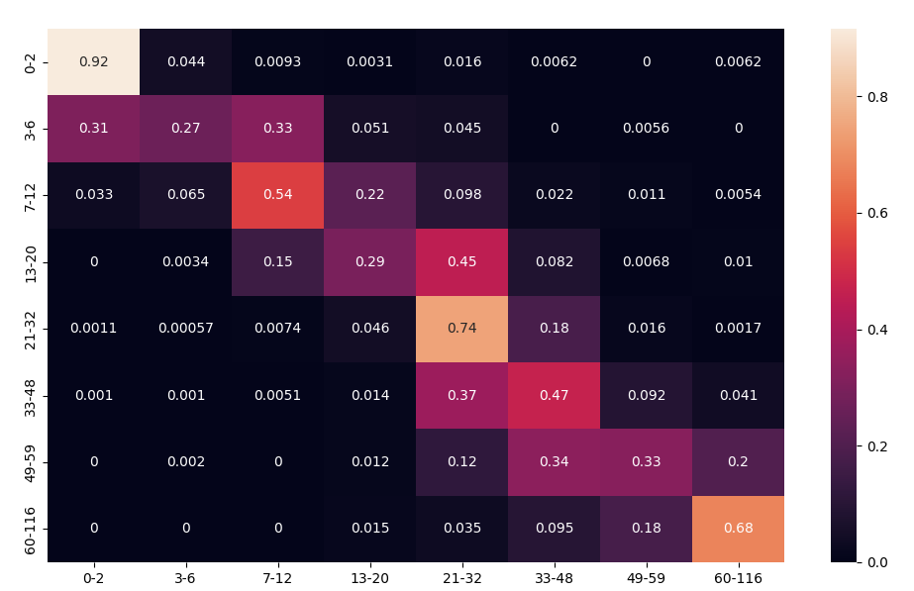
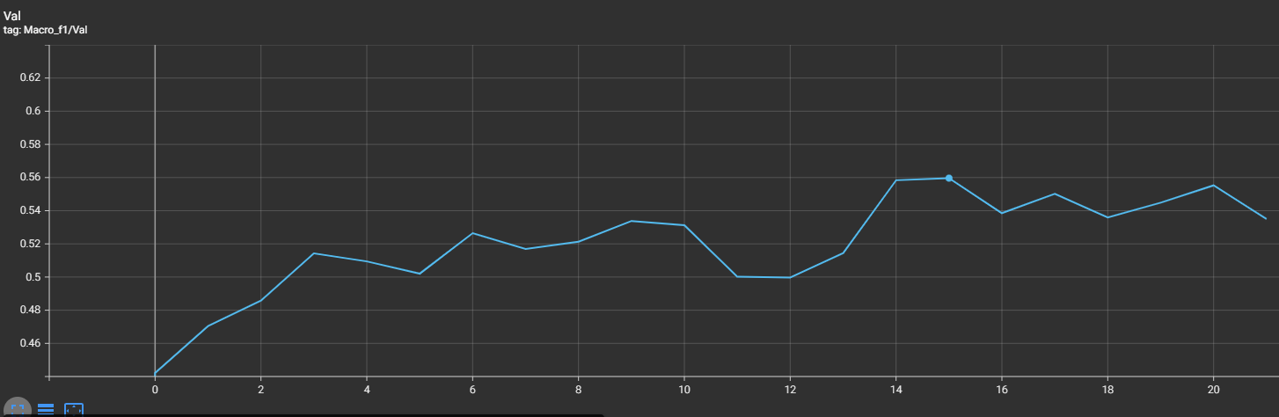
AGE Classification
Age, Gender and Ethnicity
By Bavly Benyamin, Supervised by Prof. Nahla Barakat
Trials and results
Trial 1: Base UTK model
F1 score: 55.96%

Slide 15
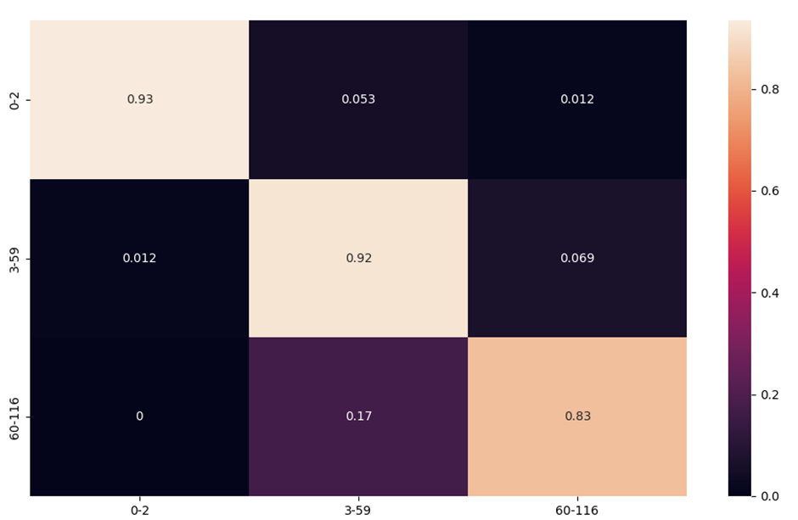
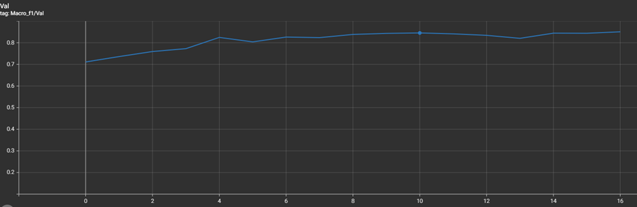
AGE Classification
Age, Gender and Ethnicity
By Bavly Benyamin, Supervised by Prof. Nahla Barakat
Trials and results
Trial 2: Age categories - 3 bins
F1 score: 84.31%

Slide 16
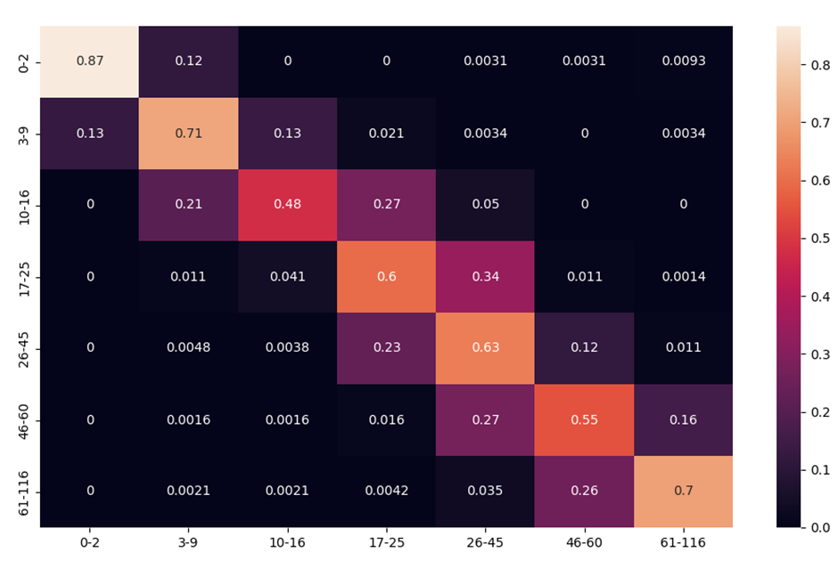
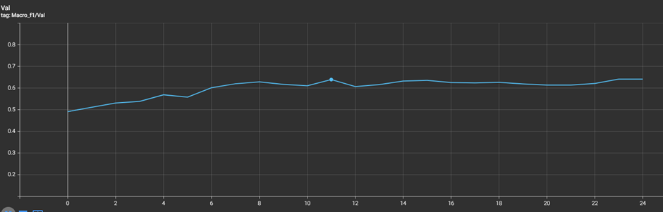
AGE Classification
Age, Gender and Ethnicity
By Bavly Benyamin, Supervised by Prof. Nahla Barakat
Trials and results
Trial 3: Age categories - 7 bins
F1 score: 63.89%

Slide 17
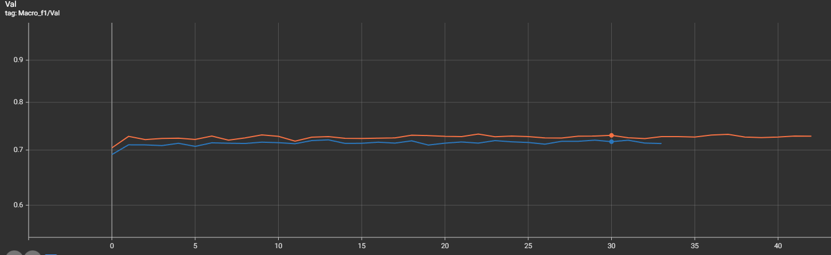
AGE Classification
Age, Gender and Ethnicity
By Bavly Benyamin, Supervised by Prof. Nahla Barakat
Trials and results
Trial 4: Hierarchical: gender -> age
F1 score male -> age: 72.95%
F1 score female -> age: 71.97%
F1 score average: 72.45%

Slide 18
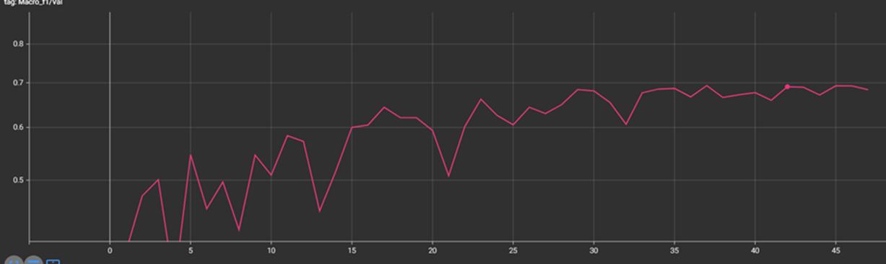
AGE Classification
Age, Gender and Ethnicity
By Bavly Benyamin, Supervised by Prof. Nahla Barakat
Trials and results
Trial 5: Transfer learning FaceNet
F1 score: 69.04%

Slide 19
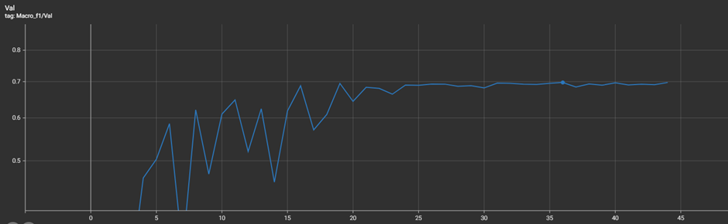
AGE Classification
Age, Gender and Ethnicity
By Bavly Benyamin, Supervised by Prof. Nahla Barakat
Trials and results
Trial 6: Residual attention
F1 score: 69.95%

Slide 20
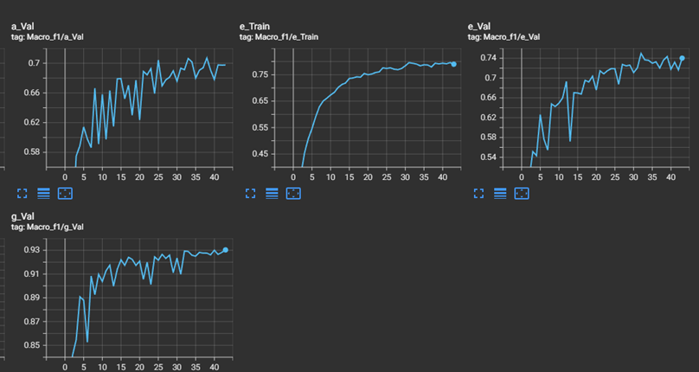
AGE Classification
Age, Gender and Ethnicity
By Bavly Benyamin, Supervised by Prof. Nahla Barakat
Trials and results
Trial 7: Multitasking
F1 score age: 70.71%
F1 score gender: 93.01%
F1 score ethnicity: 74.95%

Slide 21
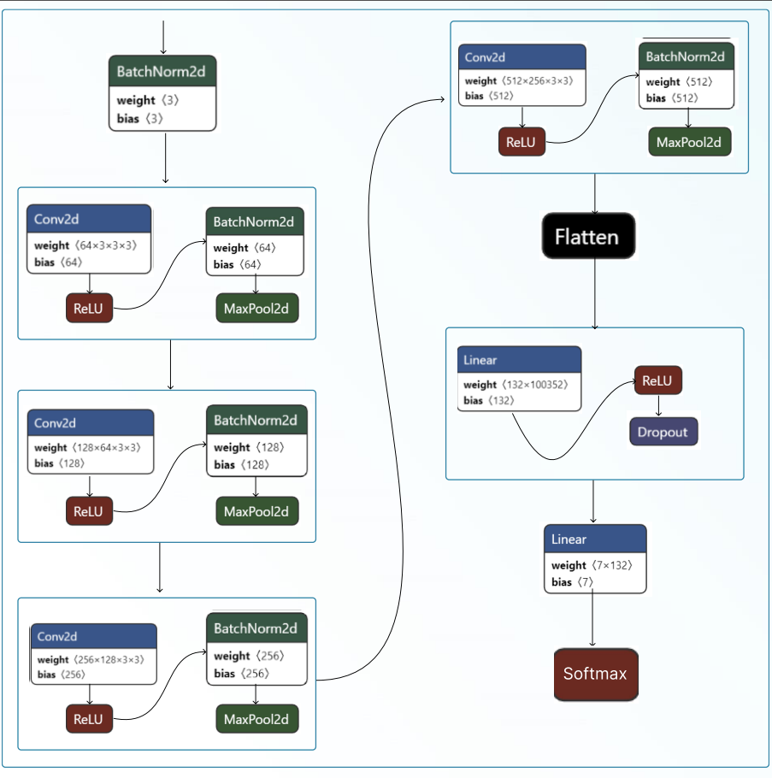
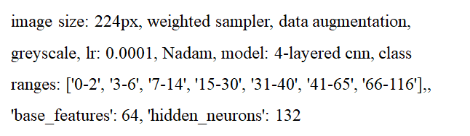
AGE Classification
Age, Gender and Ethnicity
By Bavly Benyamin, Supervised by Prof. Nahla Barakat
Trials and results
Trial 8: optimal model AGECNN

Slide 22
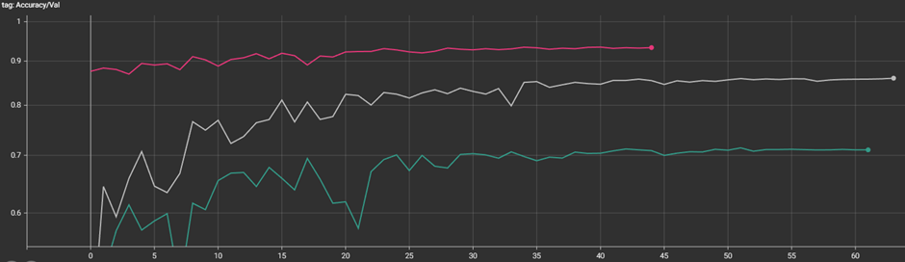
AGE Classification
Age, Gender and Ethnicity
By Bavly Benyamin, Supervised by Prof. Nahla Barakat
Trials and results
Trial 8: optimal model AGECNN
F1 score age: 73.27%
F1 score gender: 93.41%
F1 score ethnicity: 80.25%

Slide 23
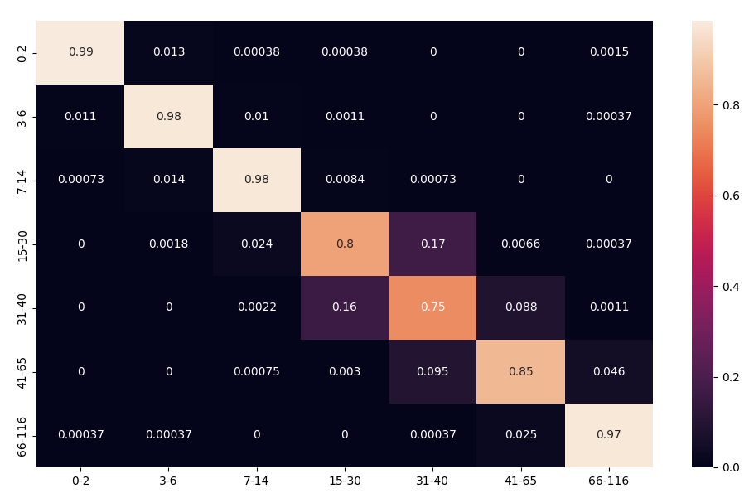
AGE Classification
Age, Gender and Ethnicity
By Bavly Benyamin, Supervised by Prof. Nahla Barakat
Trials and results
Trial 8: optimal model AGECNN: Age

Slide 24
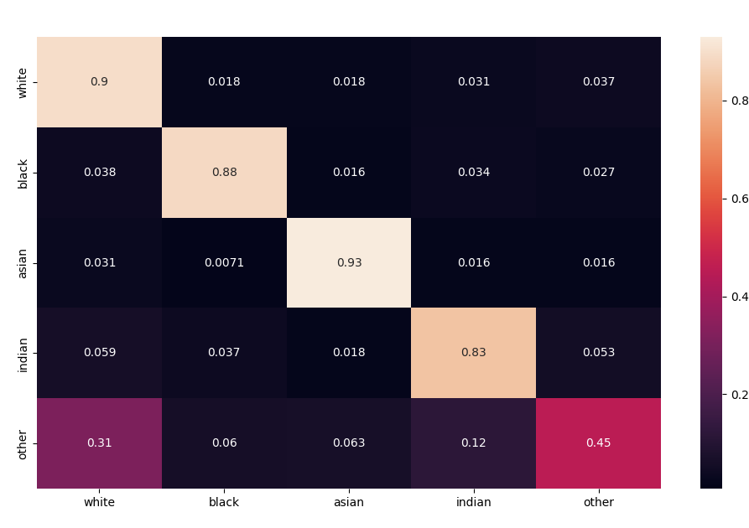
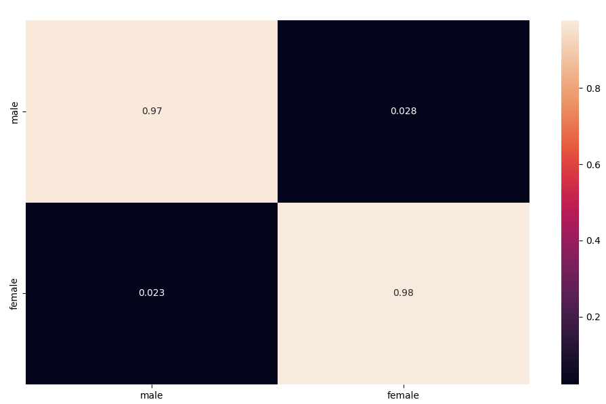
AGE Classification
Age, Gender and Ethnicity
By Bavly Benyamin, Supervised by Prof. Nahla Barakat
Trials and results
Trial 8: optimal model AGECNN: Gender and ethnicity

Slide 25
AGE Classification
Age, Gender and Ethnicity
By Bavly Benyamin, Supervised by Prof. Nahla Barakat
Trials and results
The below table uses 7 bins
Model variant | F1 score
Age categories - 3 bins | 84.31%
Age categories - 4 bins | 75.10%
Age categories - 7 bins | 65.89%
Model variant | F1 score
Base UTKFace | 55.96%
Hierarchical model | 72.45%
Transfer learning FaceNet | 69.04%
Residual attention | 69.95%
Multitasking | 70.71%
Optimal model AGECNN | 73.27%

Slide 26
AGE Classification
Age, Gender and Ethnicity
By Bavly Benyamin, Supervised by Prof. Nahla Barakat
Analysis and discussion
Why more is less
Residual Attention
Transfer learning
Hierarchical models
Multitasking

Slide 27
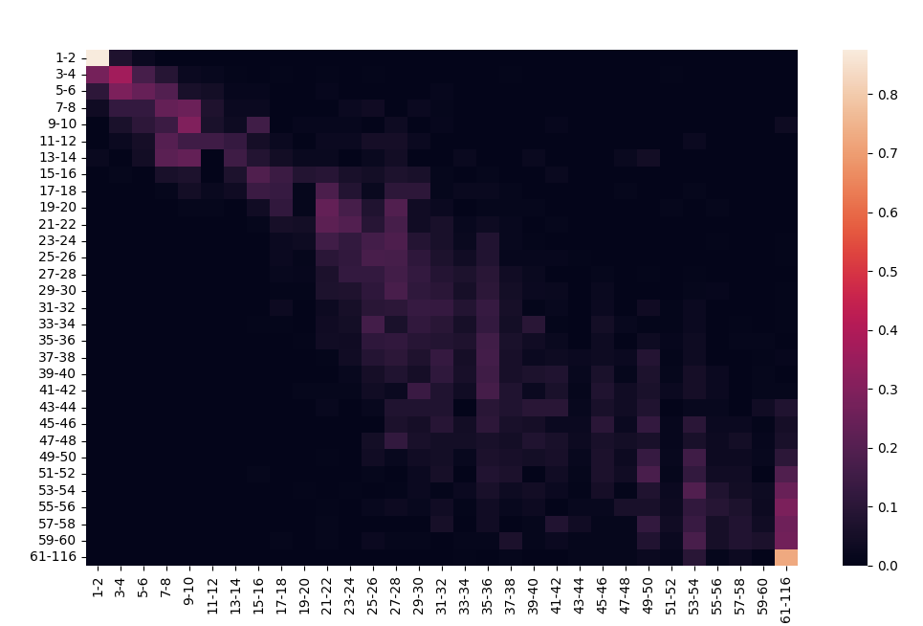
AGE Classification
Age, Gender and Ethnicity
By Bavly Benyamin, Supervised by Prof. Nahla Barakat
Analysis and discussion
Deciding on realistic age categories

Slide 28
AGE Classification
Age, Gender and Ethnicity
By Bavly Benyamin, Supervised by Prof. Nahla Barakat

Slide 29
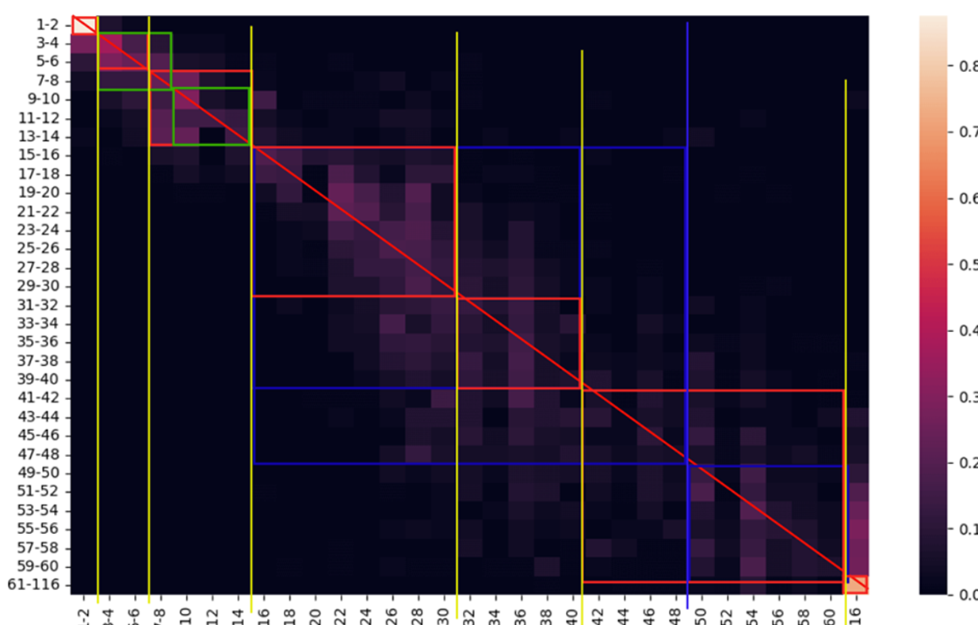
AGE Classification
Age, Gender and Ethnicity
By Bavly Benyamin, Supervised by Prof. Nahla Barakat

Slide 30
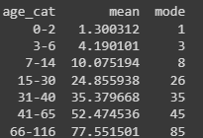
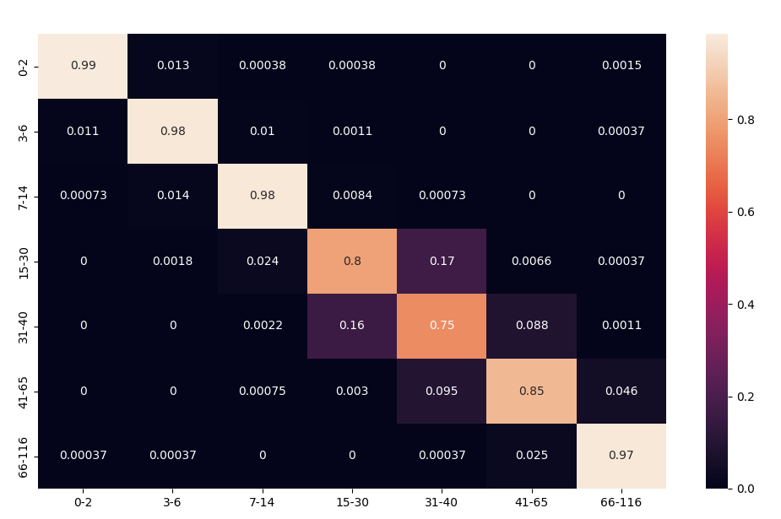
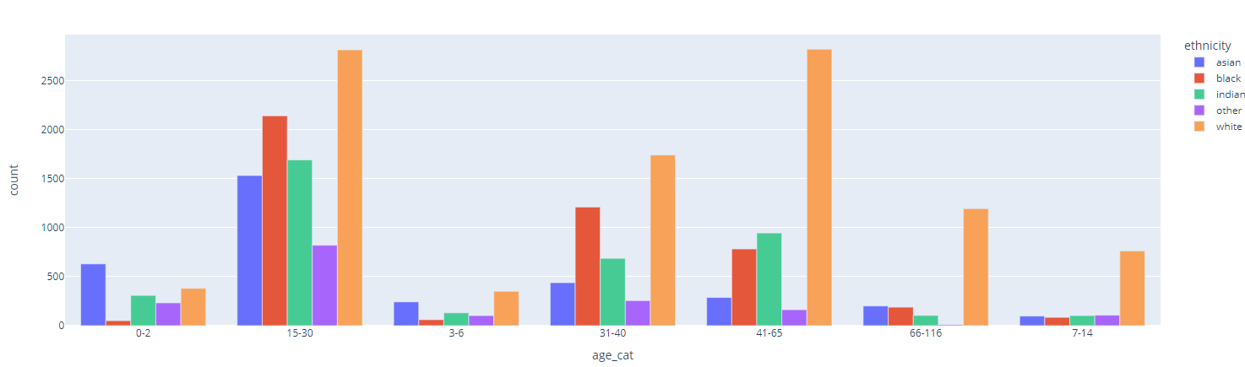
AGE Classification
Age, Gender and Ethnicity
By Bavly Benyamin, Supervised by Prof. Nahla Barakat
Analysis and discussion
Analysis of AGECNN results: Age

Slide 31
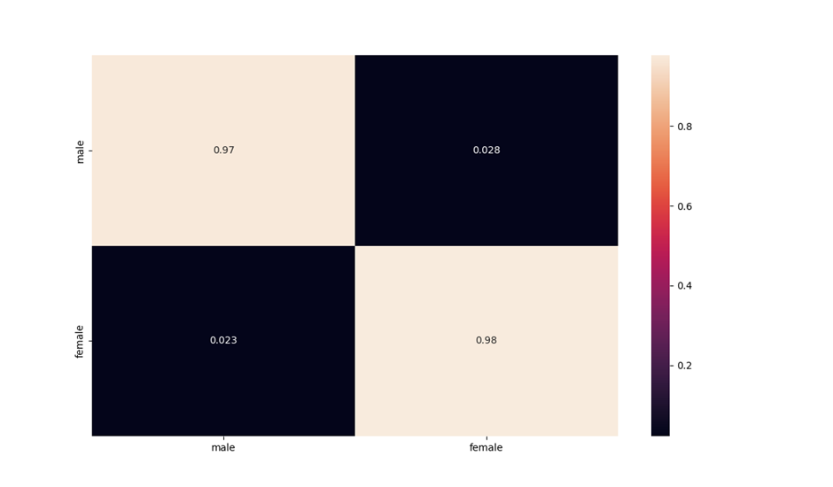
AGE Classification
Age, Gender and Ethnicity
By Bavly Benyamin, Supervised by Prof. Nahla Barakat
Analysis and discussion
Analysis of AGECNN results: Gender

Slide 32
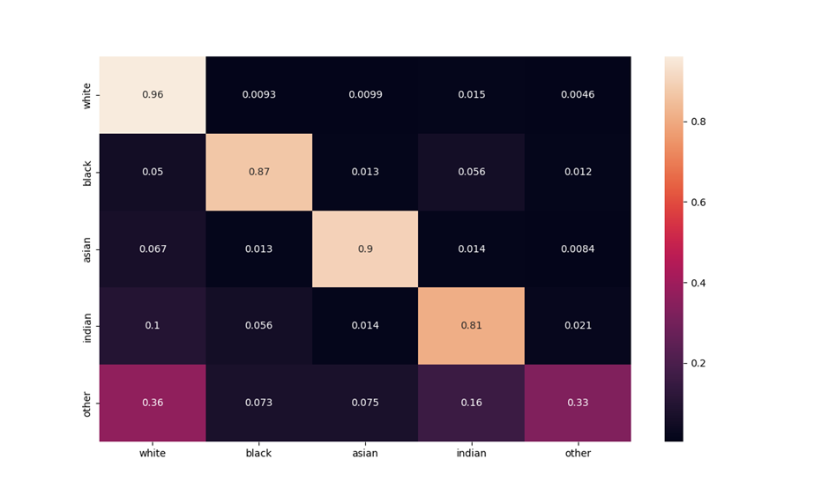
AGE Classification
Age, Gender and Ethnicity
By Bavly Benyamin, Supervised by Prof. Nahla Barakat
Analysis and discussion
Analysis of AGECNN results: Ethnicity

Slide 33
AGE Classification
Age, Gender and Ethnicity
By Bavly Benyamin, Supervised by Prof. Nahla Barakat
Analysis and discussion
Comparison with previous work: Age
Model | Metric | Value
Senet50 ‎[3] | Accuracy | 61.96%
Facenet [4] | Accuracy | 56.9%
Finetune Facenet (FFNet) [4] | Accuracy | 64.00%
MTCNN ‎[4] | Accuracy | 70.1%
ResNet50 ‎[3] | Accuracy | 64.00%
VGG16(DEX) ‎[5] | Accuracy | 67.30%
AlexNet + GoogLeNet + LeNet ‎[6] | Accuracy | 69.59%
My Proposed Residual Attention | F1 score | 69.95%
My Proposed Hierarchical model | F1 score | 72.45%
My Proposed optimal model AGECNN | F1 score | 73.27%

Slide 34
AGE Classification
Age, Gender and Ethnicity
By Bavly Benyamin, Supervised by Prof. Nahla Barakat
Analysis and discussion
Comparison with previous work: Gender
Model | Metric | Value
VGG16 ‎[2] | Accuracy | 90.04%
VGGFace ‎[7] | Accuracy | 91.60%
MobileNet ‎[8] | Accuracy | 91.95%
MTCNN [4] | Accuracy | 98.23%
StarGAN ‎[9] | Accuracy | 91.70
My Proposed Multitasking model | F1 score | 93.03%
My Proposed optimal model AGECNN | F1 score | 93.41%

Slide 35
AGE Classification
Age, Gender and Ethnicity
By Bavly Benyamin, Supervised by Prof. Nahla Barakat
Analysis and discussion
Comparison with previous work: Ethnicity
Model | Metric | Value
VGG16 ‎[10] | Accuracy | 80.00%
VGGFace ‎[10] | Accuracy | 79.00%
ResNet-34 ‎[11] | Accuracy | 83.50%
VGG-Face ‎[12] | Accuracy | 89.30%
StarGAN ‎[9] | Accuracy | 87.20
My Proposed Multitasking model | F1 score/accuracy | 74.95%/84.37%
My Proposed optimal model AGECNN | F1 score/accuracy | 80.25%/85.99%

Slide 36
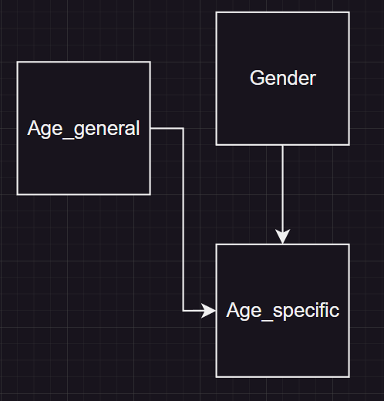
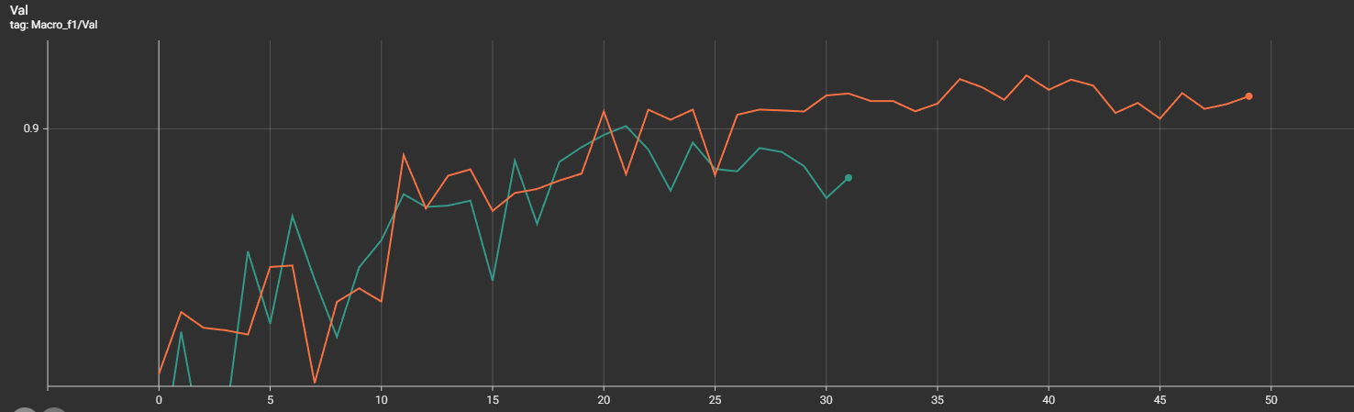
AGE Classification
Age, Gender and Ethnicity
By Bavly Benyamin, Supervised by Prof. Nahla Barakat
Conclusions and contributions
Data leakage – most valuable lesson I learnt

Slide 37
AGE Classification
Age, Gender and Ethnicity
By Bavly Benyamin, Supervised by Prof. Nahla Barakat
Conclusion and contributions
AGECNN model achieved state-of-the-art results in age classification using this set of age bins, while still maintaining competitive results in gender and ethnicity classification
Selected optimized age category bins based on both domain knowledge and data analysis
Detected a data leak while optimizing the models and handled it by separating the data from the code logic.

Slide 38
AGE Classification
Age, Gender and Ethnicity
By Bavly Benyamin, Supervised by Prof. Nahla Barakat
Conclusion and contributions
Experimented with several model architectures and learning techniques, all of which are compared and reproducible using the linked github code I wrote [13], including:
Residual attention
Transfer learning with FaceNet
Multitasking
Hierarchical models
Deep analysis that explains the current results state and discusses limitations and future work
Created a web application to demonstrate the optimal AGECNN model.

Slide 39
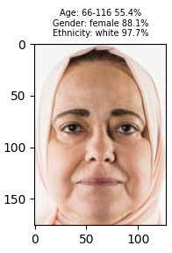
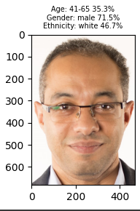
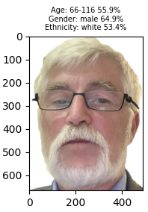
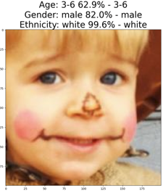
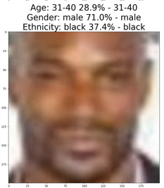
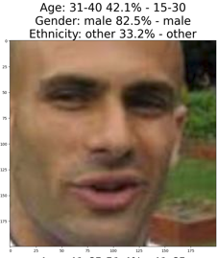
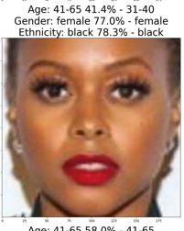
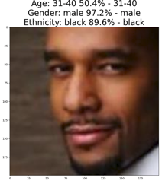
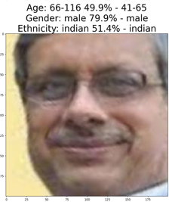
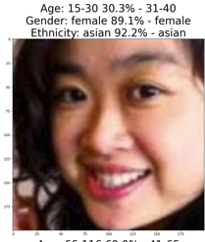
AGE Classification
Age, Gender and Ethnicity
By Bavly Benyamin, Supervised by Prof. Nahla Barakat
Web application demonstration
web app demo

Slide 40
AGE Classification
Age, Gender and Ethnicity
By Bavly Benyamin, Supervised by Prof. Nahla Barakat
References
[1] Z. Zhifei, S. Yang, and Q. Hairong, “Age progression/regression by conditional adversarial autoencoder,” in IEEE Conference on Computer Vision and Pattern Recognition. IEEE, 2017
[2] D. Yi, Z. Lei, και S. Li, ‘Age Estimation by Multi-scale Convolutional Network’, 04 2015, τ. 9005, σσ. 144–158.
[3] S. M. Uddin, M. Morshed, M. Prottoy, and A. B. M. A. Rahman, “Age Estimation from Facial Images using Transfer Learning and K-fold Cross-Validation,” Jul. 2021, pp. 33–36. doi: 10.1145/3480651.3480659.
[4] A. Das and A. Dantcheva, “Mitigating Bias in Gender, Age, and Ethnicity Classification: a Multi-Task Convolution Neural Network Approach,” Oct. 2018.
[5] R. Rothe, R. Timofte, and L. Van Gool, “Deep expectation of real and apparent age from a single image without facial landmarks,” International Journal of Computer Vision, vol. 126, no. 2, pp. 144–157, 2018.
[6] C.-J. Lin, C.-H. Lin, C.-C. Sun, and S.-H. Wang, “Evolutionary-fuzzyintegral-based convolutional neural networks for facial image classification,” Electronics, vol. 8, no. 9, p. 997, 2019.

Slide 41
AGE Classification
Age, Gender and Ethnicity
By Bavly Benyamin, Supervised by Prof. Nahla Barakat
References
[8] A. Krishnan, A. Almadan and A. Rattani, "Understanding Fairness of Gender Classification Algorithms Across Gender-Race Groups," 2020 19th IEEE International Conference on Machine Learning and Applications (ICMLA), Miami, FL, USA, 2020, pp. 1028-1035, doi: 10.1109/ICMLA51294.2020.00167.
[9] A. Savchenko, “Efficient facial representations for age, gender and identity recognition in organizing photo albums using multi-output ConvNet,” PeerJ Computer Science, vol. 5, p. e197, Jun. 2019, doi: 10.7717/peerj-cs.197.
[10] A. Deviyani, Assessing Dataset Bias in Computer Vision. 2022.
[11] M. A. Ahmed, R. D. Choudhury, and K. Kashyap, “Race estimation with deep networks,” Journal of King Saud University - Computer and Information Sciences, vol. 34, no. 7, pp. 4579–4591, 2022, doi: https://doi.org/10.1016/j.jksuci.2020.11.029
[12] Greco, A., Percannella, G., Vento, M. et al. Benchmarking deep network architectures for ethnicity recognition using a new large face dataset. Machine Vision and Applications 31, 67 (2020). https://doi.org/10.1007/s00138-020-01123-z

Slide 42
AGE Classification
Age, Gender and Ethnicity
By Bavly Benyamin, Supervised by Prof. Nahla Barakat
Q&A
Thank you for your time. Any questions?

